Slide 1
Time Sharing in Action: Disneyland Ride Queues
CPSC 351: Operating Systems Concepts
Professor Sameer Nagar
Eric Tran, Ernesto Gomez, Marinah Rubalcaba, Yash Patel, Aiden Hosanna

Slide 2
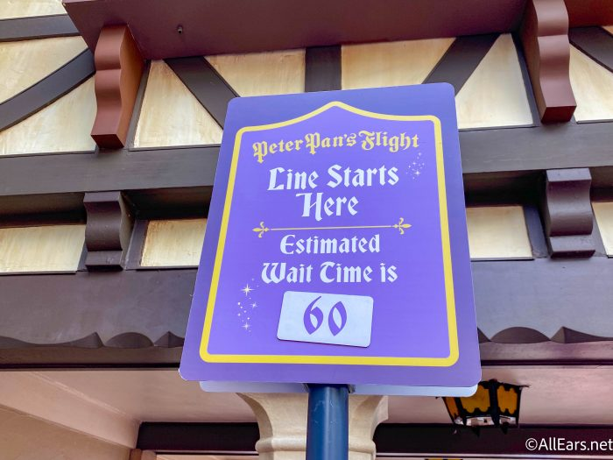
Story: Line Queues at Disneyland
Setting: Waiting in line for a ride at Disneyland.
Our goal: Help guests have a great experience at the park by balancing fairness and efficiency in lines.
Processes -> Guests joining the line queue
Arrival Time -> When a group enters the line
Burst Time -> Duration of ride, including loading time
Priority -> For guests with memberships or disabilities

Slide 3
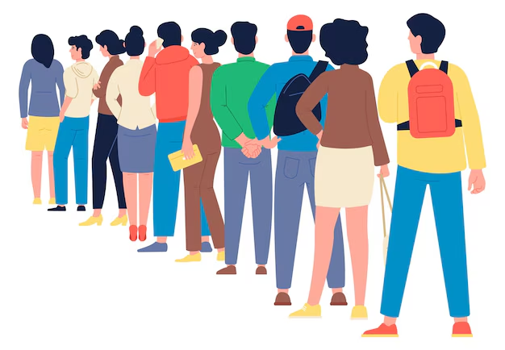
Scheduling Algorithms Overview
First-Come, First Served (FCFS):
Mirrors traditional lines where guests are served strictly by their arrival order.
Shortest Job First (SJF):
Prioritizes shorter ride durations to improve park efficiency.
Round Robin (RR):
Introduces time-sharing, rotating access to ensure fairness and responsiveness across all guest groups.

Slide 4
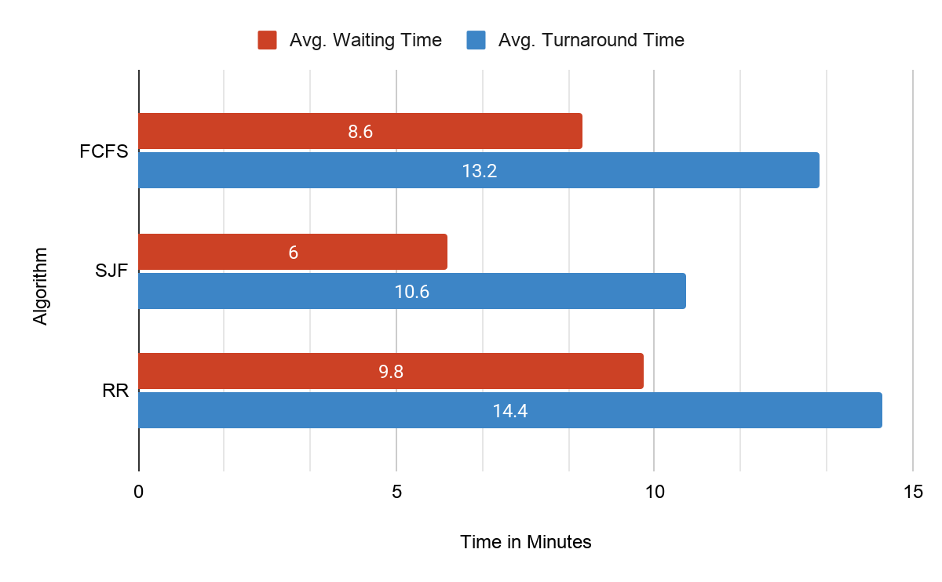
Results
Most Efficient Algorithm: SJF, with the lowest average wait time of 6 minutes and average turnaround time of 10.6 minutes.
Least Efficient Algorithm: RR had the highest average wait time of 9.8 minutes and highest average turnaround time of 14.4 minutes due to its high overhead of context switching.

Slide 5
Key insights & Conclusions
The Trade-off of Perfomance vs Fairness:
SJF had the best performance, but it is unfair and potentially unrealistic as large groups might face very long wait times (starvation).
RR ensures that every guest is regularly given the opportunity to go on their ride of choice, but wait times are generally long and could be hard to realistically implement.
FCFS was less efficient performance wise, but there is no risk of starvation and it more closely aligns with what we see as the standard of line queues.
Why this all matters: Choosing the best algorithm fitting algorithm is important as it relates directly to customer satisfaction. If wait times are too long and complicated, the “happiest place on Earth” can turn into the worst.

Slide 6
Live Demo time!

Slide 7
Any Questions?

Slide 8
Thank you for listening!

